Slide 1
Real-Time Operating Systems
Real-Time Kernels
Theoretical Foundations of RTOS
Intertask Communication & Synchronization
Memory Management
Case Study

Slide 2
Real-Time Kernels
A process is an abstraction of a running program and is the logical unit of work scheduled by OS
Threads are light-weighted processes sharing resources of the parent process
RTOS task management functions: scheduling, dispatching, intercommunication and synchronization

Slide 3
Real-Time Kernels
The kernel of the OS is the smallest portion that provides for task management functions
A scheduler determines which task will run next
A dispatcher provides a necessary bookkeeping to start the next task
Intertask communication and synchronization assures that the tasks cooperate

Slide 4
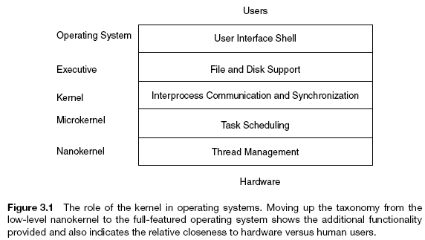
Real-Time Kernels

Slide 5
Pseudo-kernels
Polled Loop
For(;;){/*do forever*/
if (packet_here){/*check flag*/
process_data();/*process data*/ packet_here=0;/*reset flag*/
}
}
Synchronized polled loop
For(;;){/*loop forever*/
if (flag){ pause(20); /* wait 20 ms to avoid switch-bounce*/
process_event(); flag=0;
}
}

Slide 6
Cyclic Executives
For(;;){/* do forever in round-robin fashion*/
Process1();
Process2();
..
ProcessN();
}
Different rates example:
For(;;){/* do forever in round-robin fashion*/
Process1();
Process2();
Process3();/*process 3 executes 50% of the time*/
Process3();
}

Slide 7
State-Driven Code
It uses if-then, case statements or finite state automata to break up processing of functions into code segments
For(;;){/*dining philosophers*/
switch (state)
case Think: pause(random()); state=Wait; break;
case Wait: if (forks_available()) state=Eat;
case Eat: pause(random()); return_forks(); state=Think;
}
}
Return forks
Eat
Think
Take forks
Wait forks
Take forks
Wait

Slide 8
Coroutines
Void process_i(){//code of the i-th process
switch (state_i){// it is a state variable of the i-th process
case 1: phase1_i(); break;
case 2: phase2_i(); break;
..
case N: phaseN_i();break;
}
}
Dispatcher(){
For(;;){ /*do forever*/
process_1();
..
process_M();
}
1
2
N
Dispatcher

Slide 9
Interrupt-Driven Systems
Interrupt Service Routine (ISR) takes action in response to the interrupt
Reentrant code can be used by multiple processes. Reentrant ISR can serve multiple interrupts. Access to critical resources in mutually exclusive mode is obtained by disabling interrupts
On context switching save/restore:
General registers
PC, PSW
Coprocessor registers
Memory page register
Images of memory-mapped I/O locations
The stack model is used mostly in embedded systems

Slide 10
Pseudocode for Interrupt Driven System
Main(){//initialize system, load interrupt handlers
init();
while(TRUE);// infinite loop
}
Intr_handler_i(){// i-th interrupt handler
save_context();// save registers to the stack
task_i(); // launch i-th task
restore_context();// restore context from the stack
}
Work with a stack:
Push x: SP-=2; *SP=x;
Pop x: x=*SP; SP+=2;

Slide 11
Preemptive Priority System
A higher-priority task is said to preempt a lower-priority task if it interrupts the lower-priority task
The priorities assigned to each interrupt are based on the urgency of the task associated with the interrupt
Prioritized interrupts can be either priority or dynamic priority
Low-priority tasks can face starvation due to a lack of resources occupied by high-priority tasks
In rate-monotonic systems higher priority have tasks with higher frequency (rate)
Hybrid systems
Foreground-background systems (FBS)– polling loop is used for some job (background task – self-testing, watchdog timers, etc)
Foreground tasks run in round-robin, preemptive priority or hybrid mode
FBS can be extended to a full-featured real-time OS

Slide 12
The Task Control Model of Real-Time Operating System
Each task is associated with a structure called Task Control Block (TCB). TCB keeps process’ context: PSW, PC, registers, id, status, etc
TCBs may be stored as a linked list
A task typically can be in one of the four following states:
1) Executing; 2) Ready; 3) Suspended (blocked); 4) Dormant (sleeping)
Ready
Dormant
Executing
Suspended
RTOS maintains a list of the ready tasks’ TCBs and another list for the suspended tasks
When a resource becomes available to a suspended task, it is activated

Slide 13






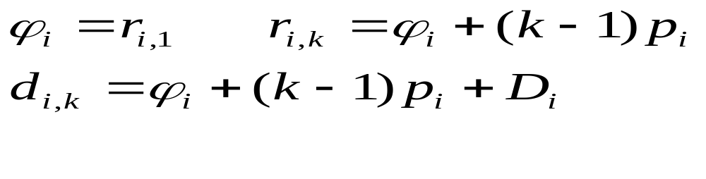
Process Scheduling
Pre-run time and run-time scheduling. The aim is to meet time restrictions
Each task is characterized typically by the following temporal parameters:
Precedence constraints; 2) Release or Arrival time of j-th instance of task i; 3) Phase ; 4) Response time; 5) Absolute deadline
6) Relative deadline
7) Laxity type – notion of urgency or leeway in a task’s execution
8) Period
9) Execution time
Assume for simplicity: all tasks are periodic and independent, relative deadline is a period/frame, tasks are preemptible, preemption time is neglected

Slide 14
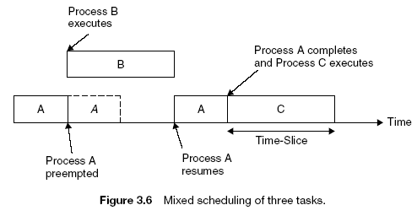
Round-Robin Scheduling

Slide 15
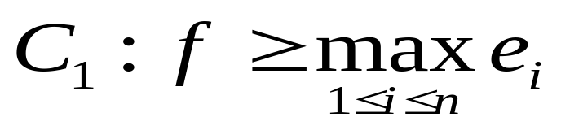
Cyclic Executives
Scheduling decisions are made periodically, rather than at arbitrary times
Time intervals during scheduling decision points are referred to as frames or minor cycles, and every frame has a length, f, called the frame size
The major cycle is the minimum time required to execute tasks allocated to the processor, ensuring that the deadlines and periods of all processes are met
The major cycle or the hyperperiod is equal to the least common multiple (lcm) of the periods, that is, lcm(p₁,..,p_{n})
Scheduling decisions are made at the beginning of every frame. The phase of each task is a non-negative integer multiple of the frame size.
Frames must be long enough to accommodate each task:

Slide 16
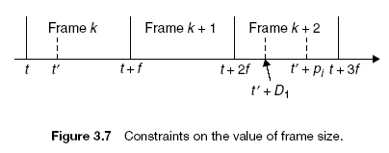
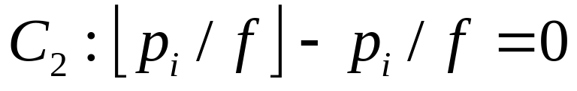
Cyclic Executives
Hyperperiod should be a multiple of the frame size:
To insure that every task completes by its deadline, frames must be small so that between the release time and deadline of every task, there is at least one frame.

Slide 17
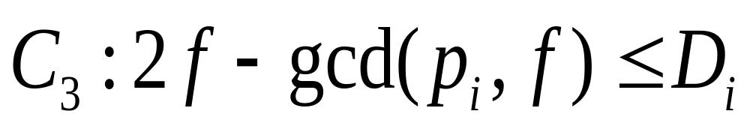
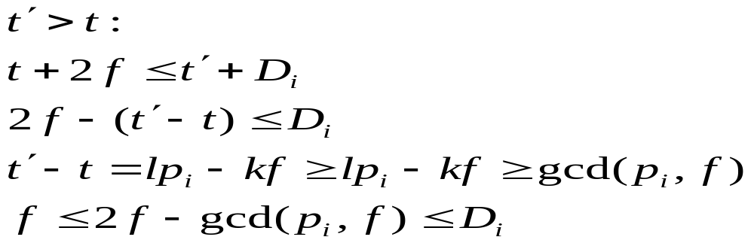
Cyclic Executives
The following relation is derived for a worst-case scenario, which occurs when the period of a process starts just after the beginning of a frame, and, consequently, the process cannot be released until the next frame:

Slide 18
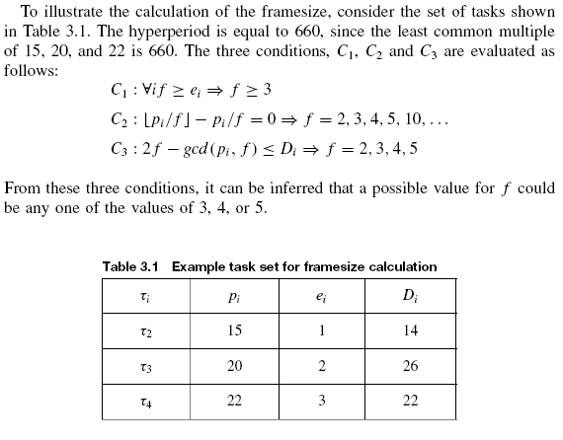
Cyclic Executives

Slide 19
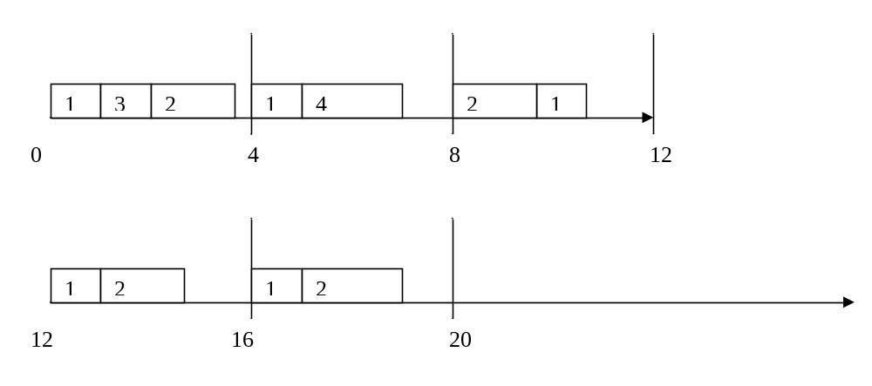
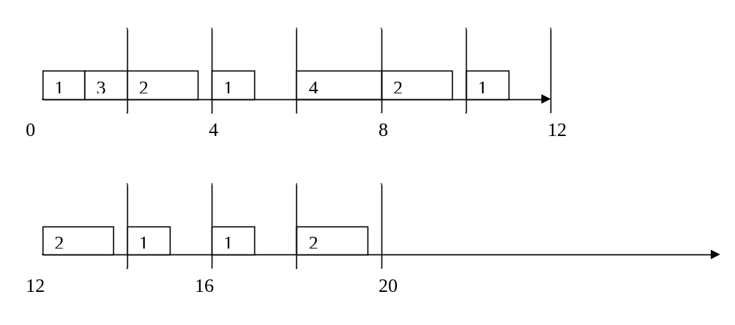
Cyclic Executives
For example, for tasks T1(4,1), T2(5,1.8), T3(20,1), T4(20,2), hyper-period is 20 (without and with frames – f=2)

Slide 20
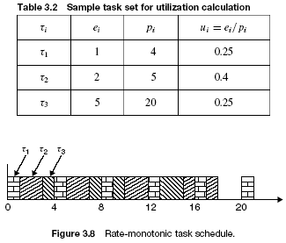
Fixed Priority Scheduling – Rate-Monotonic Approach

Slide 21
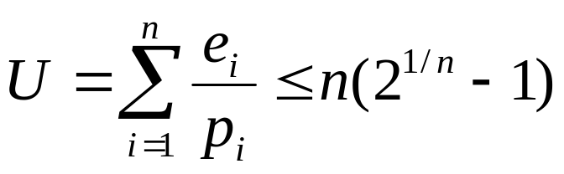
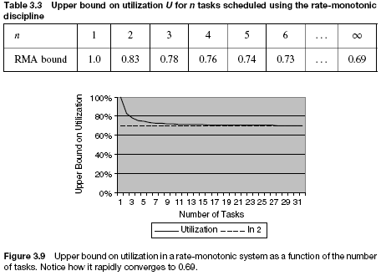
Rate-Monotonic Scheduling
Theorem (RMA Bound). Any set of n periodic tasks is RM schedulable if the processor utilization

Slide 22

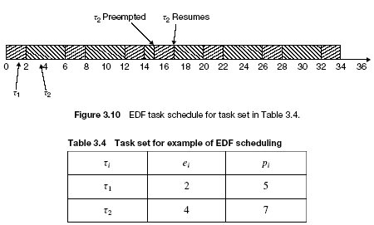
Dynamic-Priority Scheduling – Earliest-Deadline-First Approach
Theorem (EDF Bound). A set of n periodic tasks, each of whose relative deadline equals its period, can be feasibly scheduled by EDF if and only if

Slide 23
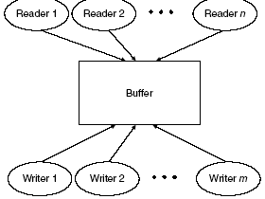
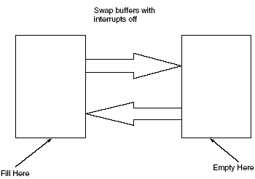
Intertask Communication and Synchronization
Buffering data
Double-buffering

Slide 24
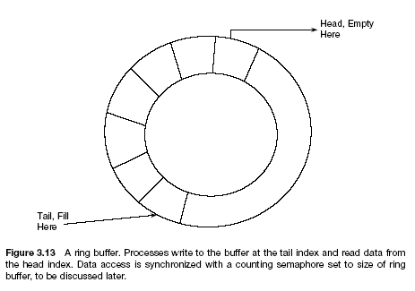
Intertask Communication and Synchronization
Ring Buffers

Slide 25
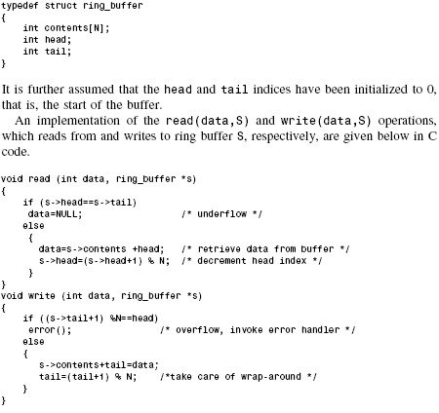
Intertask Communication and Synchronization

Slide 26
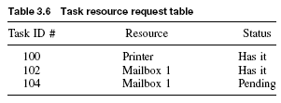
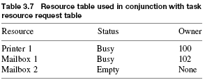
Intertask Communication and Synchronization
Mailbox: void pend (int data, s); void post (int data, s);
Access to mailbox is mutually exclusive; tasks wait access granting

Slide 27
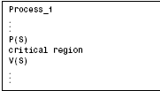
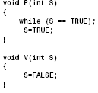
Intertask Communication and Synchronization
Queues – can be implemented with ring buffers
Critical regions – sections of code to be used in the mutually exclusive mode
Semaphores – can be used to provide critical regions

Slide 28
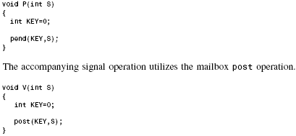
Intertask Communication and Synchronization
Mailboxes and Semaphores

Slide 29
Intertask Communication and Synchronization
Semaphores and mailboxes
Sema mutex=0/*open*/, proc_sem=1;/*closed*/
Bool full_slots=0, empty_slots=1;
Void post( int mailbox, int message){
while (1){ wait(mutex);
if (empty_slots){
insert(mailbox, message); update(); signal(mutex);
signal(proc_sem); break;
}
else{ signal(mutex); wait(proc_sem);
}
}
}

Slide 30
Intertask Communication and Synchronization
Semaphores and mailboxes
Void pend( int mailbox, int *message){
while (1){ wait(mutex);
if (full_slots){
extract(mailbox, message); update(); signal(mutex);
signal(proc_sem); break;
}
else{ signal(mutex); wait(proc_sem);
}
}
}

Slide 31
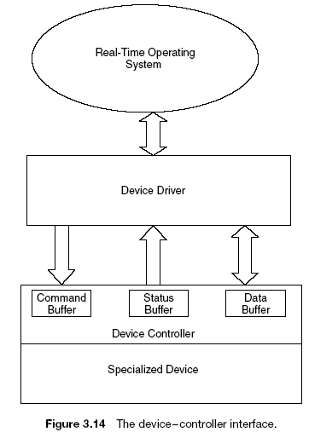
Intertask Communication and Synchronization
Driver{ while(1){
if(data_for_I/O){
prepare(command);
V(busy); P(done);}
}}
Controller{while(1){
P(busy); exec(command);
V(done);
}}

Slide 32
Intertask Communication and Synchronization
Counting Semaphores:
Wait: void MP(int &S){
S=S-1; while(S<0);
}
Signal: void MV(int &S){
S=S+1
}

Slide 33
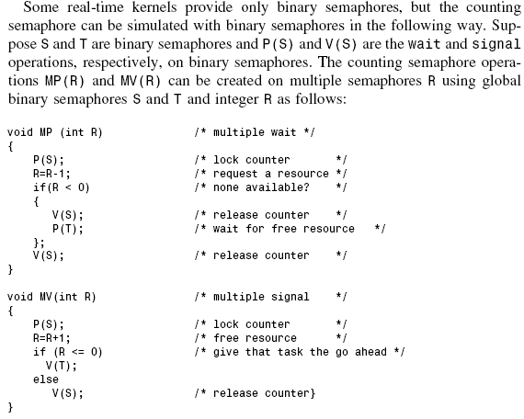
Intertask Communication and Synchronization

Slide 34
Intertask Communication and Synchronization
Problems with semaphores:
Wait: void P(int &S){
while(S==TRUE);
S=TRUE;
}
LOAD R1,S ; address of S in R1
LOAD R2,1 ; 1 in R2
@1 TEST R1,I,R2 ; compare (R1)=*S with R2=1
JEQ @1 ; repeat if *S=1
STORE R2,S,I ; store 1 in *S
Interruption between JEQ and STORE, passing control to a next process, can cause that several processes will see *S=FALSE

Slide 35
Intertask Communication and Synchronization
The Test-and-Set Instruction
Void P(int &S){
while(test_and_set(S)==TRUE);//wait
}
Void V(int &S){
S=FALSE;
}
The instruction fetches a word from memory and tests the high-order (or other) bit . If the bit is 0, it is set to 1 and stored again, and a condition code of 0 is returned. If the bit is 1, a condition code of 1 is returned and no store is performed. The fetch, test and store are indivisible.

Slide 36
Intertask Communication and Synchronization
Dijkstra’s implementation of semaphore operation (if test-and-set instruction is not available):
Void P(int &S){
int temp=TRUE;
while(temp){
disable(); //disable interrupts
temp=S;
S=TRUE;
enable(); //enable interrupts
}
}

Slide 37
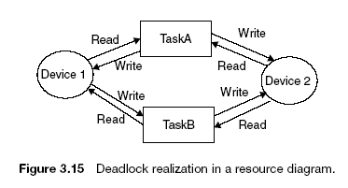
Intertask Communication and Synchronization
Other Synchronization Mechanisms:
Monitors (generalize critical sections – only one process can execute monitor at a time. Provide public interface for serial use of resources
Events – similar to semaphores, but usually all waiting processes are released when the event is signaled. Tasks waiting for event are called blocked
Deadlocks

Slide 38
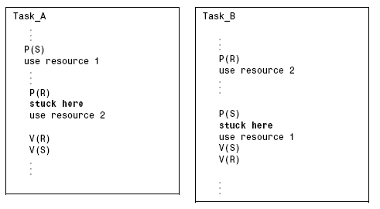
Intertask Communication and Synchronization
Deadllocks:

Slide 39
Deadlocks
Four conditions are necessary for deadlock:
Mutual exclusion
Circular wait
Hold and wait
No preemption
Eliminating any one of the four necessary conditions will prevent deadlock from occurring
One way to eliminate circular wait is to number resources and give all the resources with the numbers greater or equal than minimal required to processes. For example: Disk – 1, Printer – 2, Motor control – 3, Monitor – 4. If a process wishes to use printer, it will be assigned printer, motor control and monitor. If another process requires monitor, it will have wait until the monitor will be released. This may lead to starvation.

Slide 40
Deadlock avoidance
To avoid deadlocks, it is recommended :
Minimize the number of critical regions as well as minimizing their size
All processes must release any lock before returning to the calling function
Do not suspend any task while it controls a critical region
All critical regions must be error-free
Do not lock devices in interrupt handlers
Always perform validity checks on pointers used within critical regions.
It is difficult to follow these recommendations

Slide 41
The Banker’s Algorithm
Suggested by Dijkstra in 1968 for a single resource, but then was extended to multiple resource types by Habermann in 1969.
Consider a system with three processes:
Process | Max requirement | Used | Possibly needed
A | 6 | 0 | 6
B | 5 | 0 | 5
C | 7 | 0 | 7
 |  | Total available | 10

Slide 42
The Banker’s Algorithm
When resources are requested, the operating system updates the table, ensuring that a possible deadlock state is not reached. An example of a “safe state” is
Process | Max requirement | Used | Possibly needed
A | 6 | 2 | 4
B | 5 | 3 | 2
C | 7 | 1 | 6
 |  | Total available | 4

Slide 43
The Banker’s Algorithm
An example of an “unsafe state” is:
Process | Max requirement | Used | Possibly needed
A | 6 | 4 | 2
B | 5 | 3 | 2
C | 7 | 2 | 5
 |  | Total available | 1

Slide 44
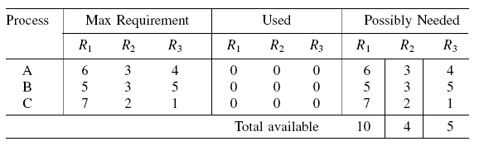
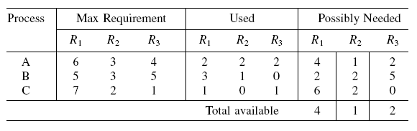
The Banker’s Algorithm
The case of multiple resources. Initial resource state:
Safe state:

Slide 45
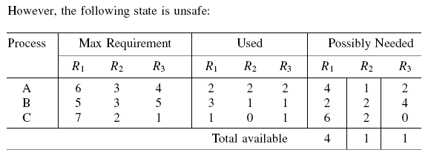
The Banker’s Algorithm

